Slide 1




WP6: Progress with enhancement of existing software
Developments towards deliverable D6.1 in month 12
Wouter Addink on behalf of the WP6 team
4D4Life Second Meeting, 16-18 February 2010, Faro, Portugal

Slide 2



Base Schema (task 6.6)
The Base Schema is a schema describing how Standard Dataset data should be arranged in a relational database.
It will be the core of all relational databases used in the CoL infrastructure and replaces the different schemas that are currently in use, for example:
  AC production DB,
  AC assembly DB,
  Data Exchange Templates,
  SPICE caches,
  Dilshat's Downloader,
  Jorrit's Optimised Schema
4D4Life Second Meeting, 16-18 February 2010, Faro, Portugal

Slide 3
Path followed towards the new schema:
Pre-meeting with Design Team Sept 2009 in Reading to discuss ideas
Draft design at ETI, comparison with existing standards and schemas
Base schema proposal reviewed and adopted by the Design Team Oktober 2009 at a workshop in Amsterdam (Milestone M6.1)
Base schema plus documentation sent to a wider audience for review
Publication of the Base schema on the 4D4Life Wiki
The published version of the Base Schema is called ‘Interim Schema’ because updates may be needed in next stages of the 4D4Life project
4D4Life Second Meeting, 16-18 February 2010, Faro, Portugal

Slide 4
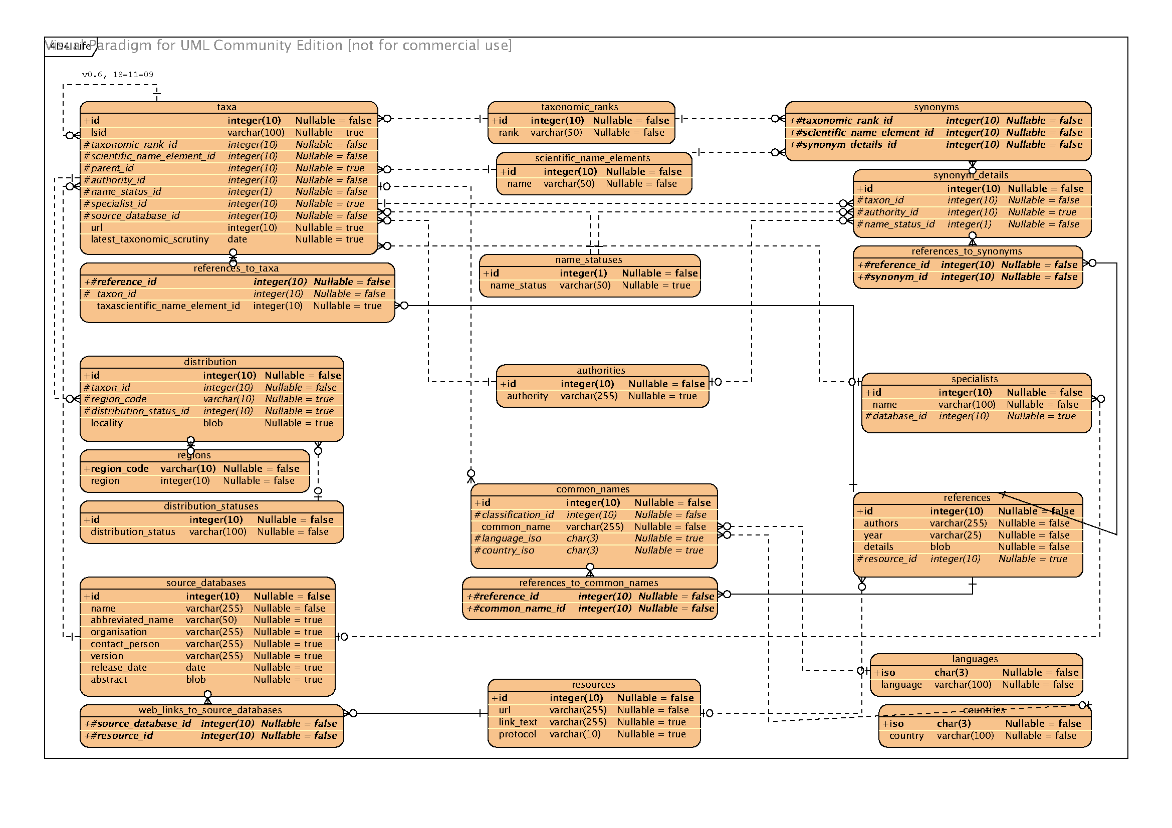

4D4Life Second Meeting, 16-18 February 2010, Faro, Portugal

Slide 5
Some characteristics of the Base Schema
Based on the current Annual Checklist schema
Versioned
Normalized schema with atomized names – no data redundancy
Controlled (but extendible) vocabulary for taxonomic ranks
Controlled vocabulary for distributions (proposed: TDWG regions and WORMS marine areas) while keeping the option to use a text representation of localities for backwards compatibility
Data stored in Unicode
Allows for multiple taxonomic interpretations (supports Multi-Hub architecture)
‘Floating names’ supported
4D4Life Second Meeting, 16-18 February 2010, Faro, Portugal

Slide 6
Overview of the Enhancements and New Features Implemented for the Annual Checklist Interface (Milestone M6.2)
4D4Life Second Meeting, 16-18 February 2010, Faro, Portugal

Slide 7
Enhancements to the
Annual Checklist Interface
Improvements
Improved Display of Common Names
Search Queries and Match Highlighting
New Column “Group”
Bi-directional Sort by Column
Results Counter
Improved Results Paginator
Single Step Form Validation
Source Database Details
4D4Life Second Meeting, 16-18 February 2010, Faro, Portugal

Slide 8

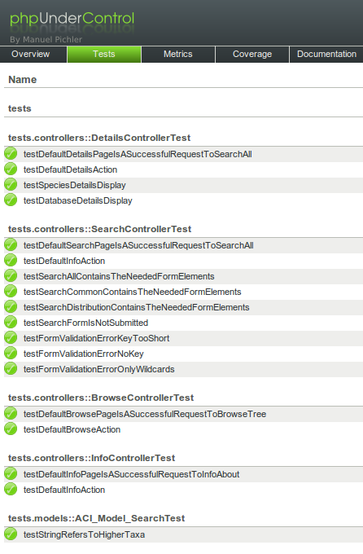
Scalability, Maintainability and Quality
Built on a stable framework implementing the MVC design pattern
Modular and easy to extend
Automated testing of source code
Version control
Standardized and automated sourcecode documentation
Implementation history maintained in Issue tracking system
4D4Life Second Meeting, 16-18 February 2010, Faro, Portugal

Slide 9
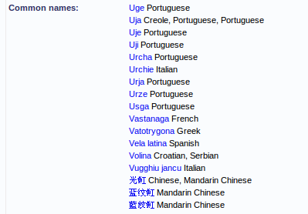
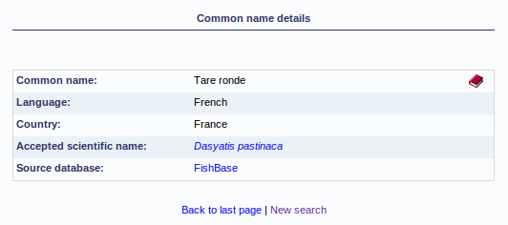
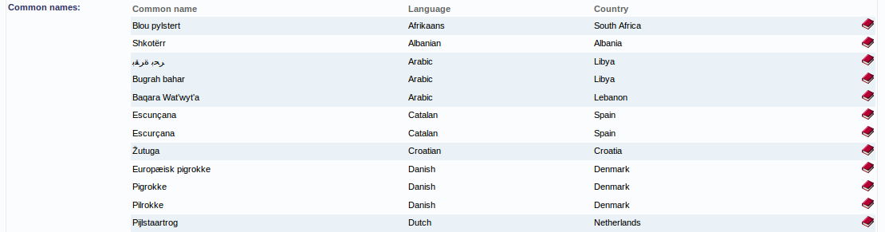
Display of Common Names
4D4Life Second Meeting, 16-18 February 2010, Faro, Portugal

Slide 10
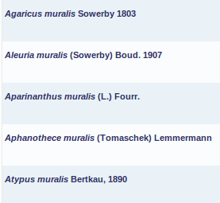
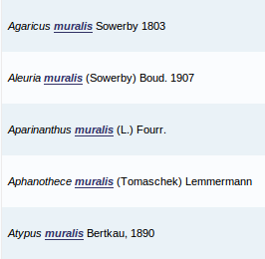
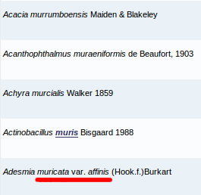
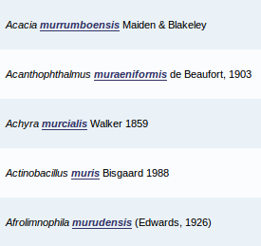
Search Queries and Match Highlighting
Scientific names
Specific epithet: muralis
Match whole words
All names
Key: mur*is
Match whole words
4D4Life Second Meeting, 16-18 February 2010, Faro, Portugal

Slide 11
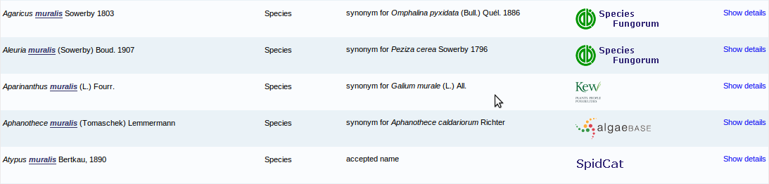
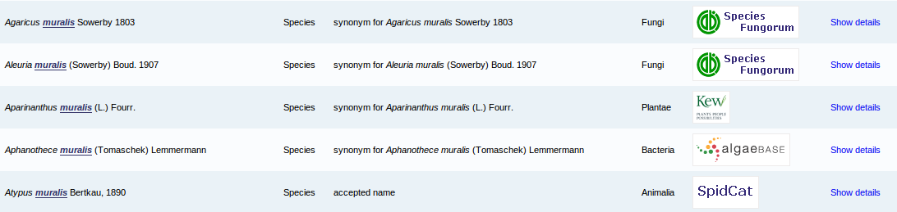
New Column ”Group”
4D4Life Second Meeting, 16-18 February 2010, Faro, Portugal

Slide 12
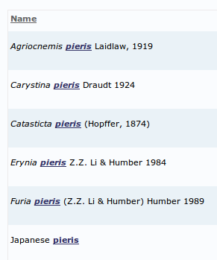
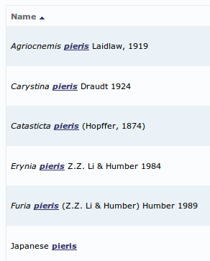
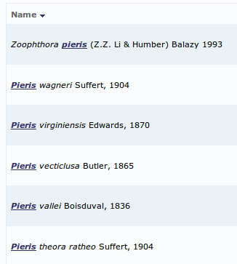
Bidirectional Sort by Column
Sorting enabled in all result pages including the source databases list
4D4Life Second Meeting, 16-18 February 2010, Faro, Portugal

Slide 13
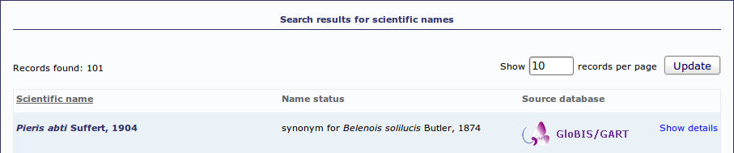
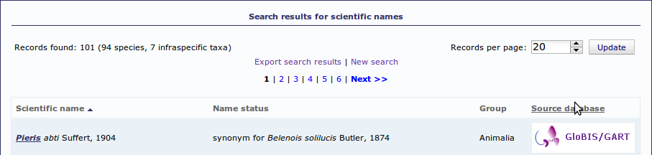
Results Counter
4D4Life Second Meeting, 16-18 February 2010, Faro, Portugal

Slide 14

Results Paginator
Shown at the top and and the bottom of the results page
Always displays the first and the last page
4D4Life Second Meeting, 16-18 February 2010, Faro, Portugal

Slide 15
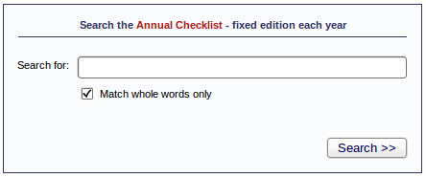
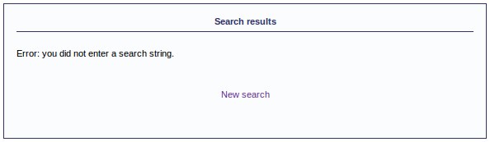
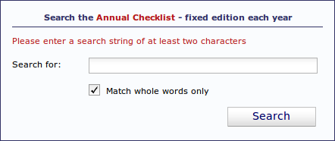
Single Step Form Validation
4D4Life Second Meeting, 16-18 February 2010, Faro, Portugal

Slide 16
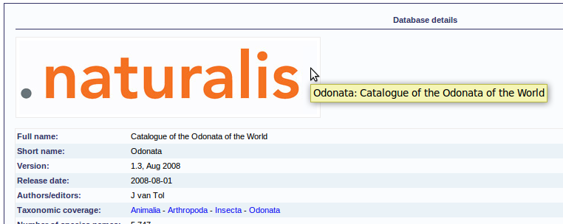
Source Database Details
Support for white-backgrounded logos by default
Link to the source database website by clicking on the logo
Taxonomic coverage linked to taxonomic browser
4D4Life Second Meeting, 16-18 February 2010, Faro, Portugal

Slide 17
New Features in the Annual Checklist Interface
New features
Multi-Language Support
Friendly URLs
Dynamic Taxonomic Tree
Dynamic Search Hinting
Google Analytics Tracking
Scalability, Maintainability and Quality
4D4Life Second Meeting, 16-18 February 2010, Faro, Portugal

Slide 18
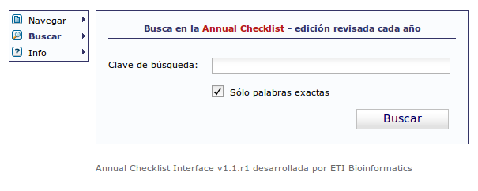
Multi-Language Support
Several possible formats (Csv, Ini, Xliff, Tmx, Gettext, ...)
4D4Life Second Meeting, 16-18 February 2010, Faro, Portugal

Slide 19
Friendly URLs
http://dev.4d4life.eu/AC_Interface/search/all
http://dev.4d4life.eu/AC_Interface/search/common
http://dev.4d4life.eu/AC_Interface/search/scientific
http://dev.4d4life.eu/AC_Interface/search/all/key/muralis/match/1
http://dev.4d4life.eu/AC_Interface/browse/classification/name/Symbiida
http://dev.4d4life.eu/AC_Interface/browse/tree/id/251
http://dev.4d4life.eu/AC_Interface/details/species/id/6206575
http://dev.4d4life.eu/AC_Interface/details/database/id/15
http://dev.4d4life.eu/AC_Interface/info/about
(...)
4D4Life Second Meeting, 16-18 February 2010, Faro, Portugal

Slide 20
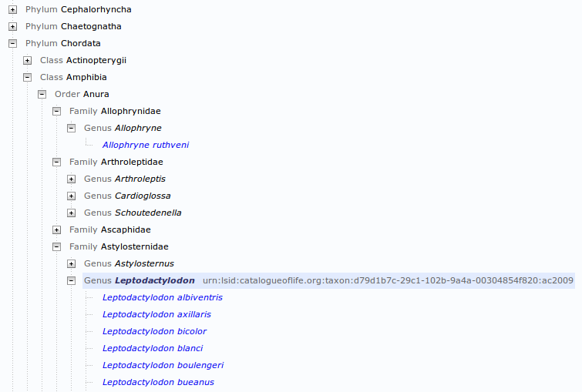
Dynamic Taxonomic Tree
4D4Life Second Meeting, 16-18 February 2010, Faro, Portugal

Slide 21
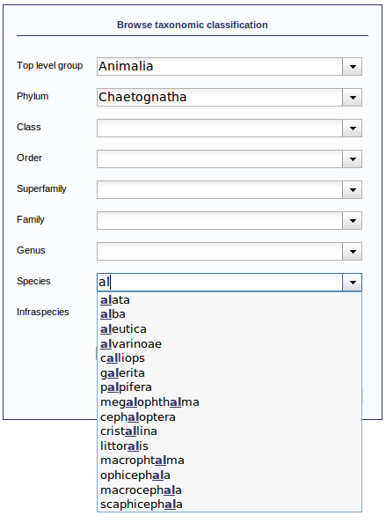
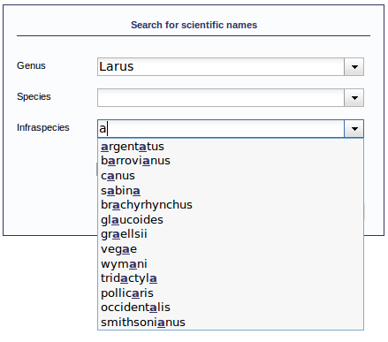
Dynamic Search Hinting
4D4Life Second Meeting, 16-18 February 2010, Faro, Portugal

Slide 22
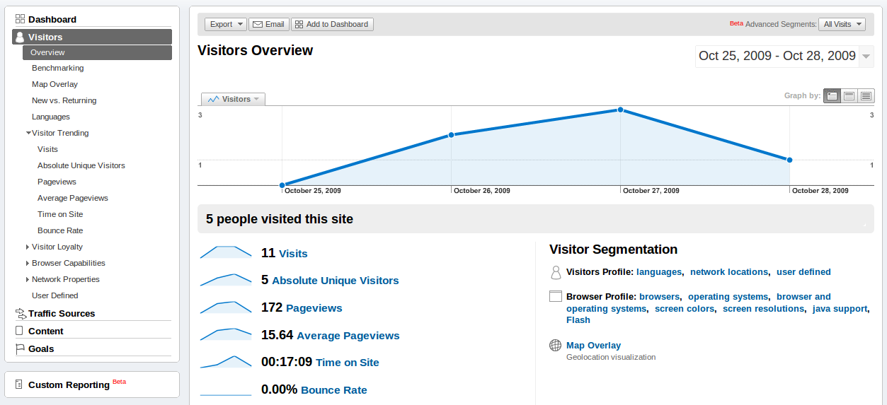
Google Analytics Tracking
4D4Life Second Meeting, 16-18 February 2010, Faro, Portugal

Slide 23
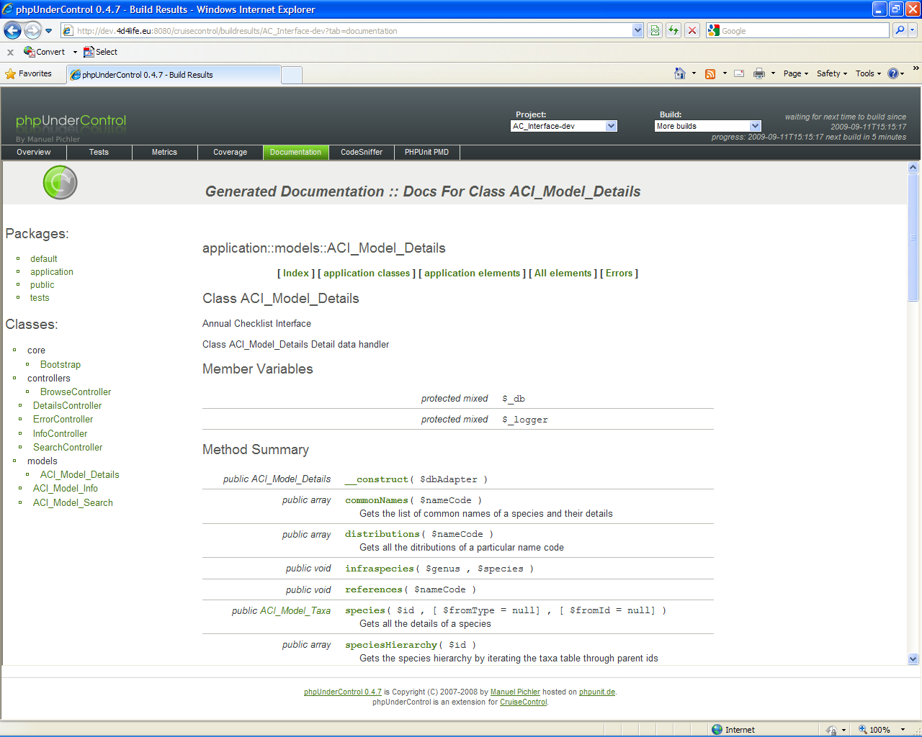
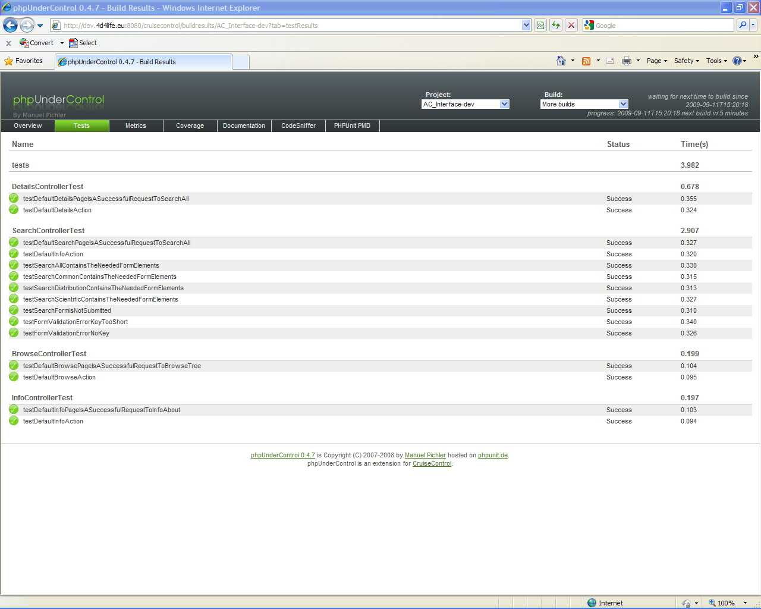
Successfull usage of
Development infrastructure (Task 6.0)
4D4Life Second Meeting, 16-18 February 2010, Faro, Portugal

Slide 24
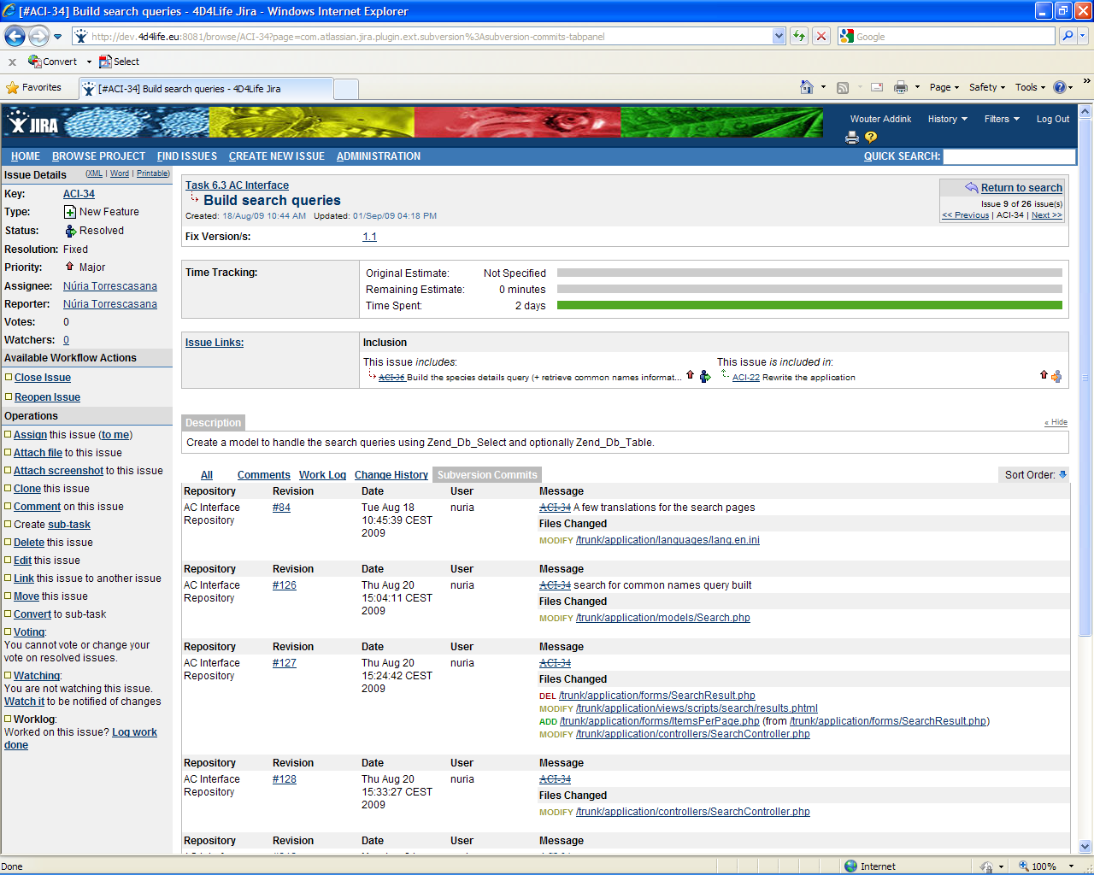
4D4Life Second Meeting, 16-18 February 2010, Faro, Portugal

Slide 25

What’s next:
Annual Checklist 2010
DVD production to provide support for Mac and Linux in addition to Windows
Interface versioned with release-version for publications and
(hidden) build-version for support
Software licence document
Available April 2010
4D4Life Second Meeting, 16-18 February 2010, Faro, Portugal

Slide 26
What’s next:
Unification of the Annual Checklist with the Dynamic Checklist
The unification is intended to be an iterative process held in two main phases:
1. The establishment of a new system architectured around the base schema, and consisting of:
  A Unified Web Interface for both the Annual and the Dynamic Checklist
  A Web Services Framework
  A Quality Assurance Workbench
  A Conversion Tool to import the existing data into the base schema structure
  A Metadatabase application bound to the base schema
2. The replacement of the data gathering processes run to build the checklists with improved and automated ones
4D4Life Second Meeting, 16-18 February 2010, Faro, Portugal

Slide 27
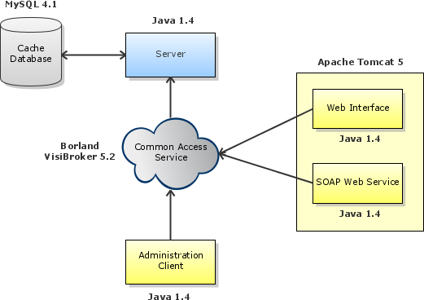
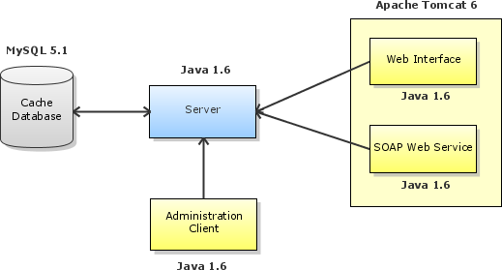
SPICE CAS enhancements
SPICE-CAS 5.2
SPICE-CAS 5.3
4D4Life Second Meeting, 16-18 February 2010, Faro, Portugal

Slide 28
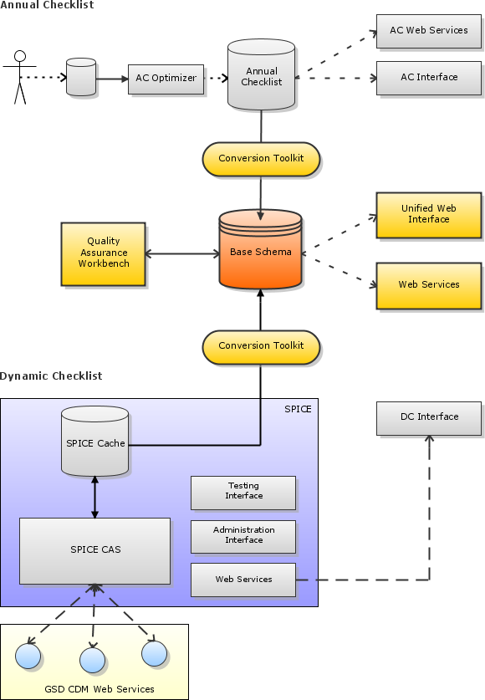
4D4Life Second Meeting, 16-18 February 2010, Faro, Portugal

Slide 29
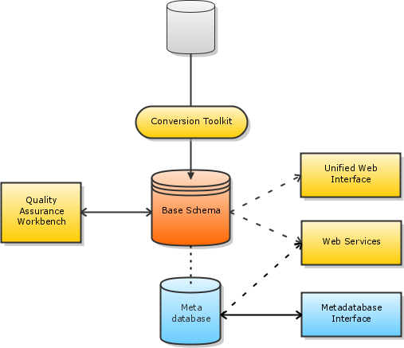
Metadatabase
The Metadatabase is currently an autonomous application unrelated to any other component of the system.
After the unification process, its information will be linked to the data in the base schema in a way that it keeps a certain consistency and its contents can be retrieved using the common Web Services Framework.
4D4Life Second Meeting, 16-18 February 2010, Faro, Portugal

